Slide 1
UI Control using Hand Gesture Recognition
TEAM 5:
SREYA VENUGOPAL
HARITHA K V

Slide 2
ABSTRACT
With the increasing demand for touchless interactions, hand gesture recognition has become an essential technology in Human-Computer Interaction (HCI). This project aims to develop a web-based UI control system where users can navigate web pages using hand gestures. The system will utilize Google's MediaPipe for real-time hand tracking and Flask for web application development.

Slide 3
Understanding Hand Gesture Recognition
Hand gesture recognition is a computer vision technique that detects and interprets hand movements. It is widely used in applications like:
Touchless UI (gesture-controlled interfaces)
Gaming (motion-based interactions)
Sign Language Translation
Virtual Reality (VR) and Augmented Reality (AR)

Slide 4
REQUIREMENTS
We need Python and the following libraries:
MediaPipe: For hand tracking
OpenCV: For capturing video from a webcam
Flask: To integrate the gesture-controlled UI with a web application

Slide 5
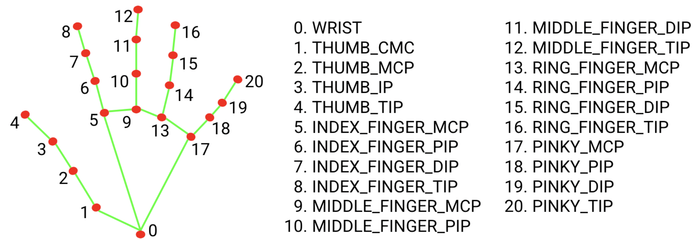
MEDIA PIPE
It is an open-source framework developed by Google that provides real-time hand-tracking capabilities.
The Hand Tracking module detects 21 key points (landmarks) on a hand using a camera.
Gesture classification model bundle
It can recognize these common hand gestures:
0 - Unrecognized gesture, label: Unknown
1 - Closed fist, label: Closed_Fist
2 - Open palm, label: Open_Palm
3 - Pointing up, label: Pointing_Up
4 - Thumbs down, label: Thumb_Down
5 - Thumbs up, label: Thumb_Up
6 - Victory, label: Victory
7 - Love, label: ILoveYou
Hand landmark model bundle

Slide 6
THANK YOU…

